Slide 1

CSE546: Final project presentation
By: Sophie Vongsiri
Recording link:
SophieVongsiri_FinalProjectRecording.mp4

Slide 2
Chosen classifiers, Parameters, analysis technique
Classifiers
KNN
SVM
Random Forest
MLP
Data Sets
PCA with 10, 50, 200, 400 components
Standard Scaler
Feature Selection:
50 most important features
Variance < .02
Original Data
Steps
Perform GridSearch and/or Pipeline over different datasets and parameters with 4-fold cross validation
Identify dataset based suited for classifier based on accuracy and/or AUC of ROC and F1 measure
Graph best performing dataset(s) over different parameters with 4-fold cross validation
Compare training and validation accuracy, AUC of ROC, F1 measure, and consistency of accuracy across the 4 folds

Slide 3
KNN: gridsearch & Pipeline
Parameters:
Used all datasets
Only classifier that uses feature selection since KNN especially struggles with high-dimensional data
Neighbors = 10, 50, 80, 100, 150, 210
Evaluation:
Training & validation accuracy, AUC of ROC, F1 measure
Conclusion:
Best overall dataset: PCA50
For each dataset’s findings, view Figure 1
Dataset | Findings
KBest | Severely underfit – all scores were low
PCA10 | Minimized the gap between accuracies but kept all scores lower than other datasets
PCA50 | Consistently had smallest gap between accuracies and highest F1 score. As K increased, AUC of ROC become highest of all datasets
PCA200, 400, Original, Scaled, Variance | Kept measures high (all relatively similar to each other and to PCA50), but larger gap between accuracies – potential for overfitting
Figure 1

Slide 4
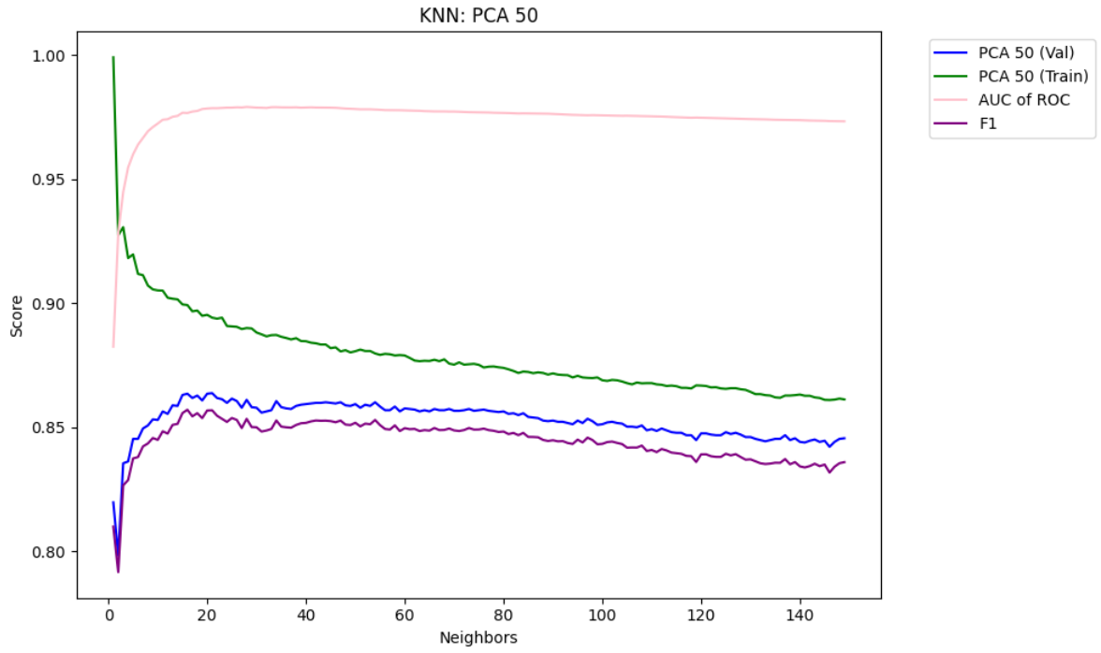
Knn: Optimal parameters for pca50
Parameters:
K values 1 – 150
Optimal Parameters
K = 54
Training = 0.8797
Validation = 0.866
Difference = 0.197
AUC of ROC = 0.9781
F1 = 0.8529
Minimizes the gap while retaining relatively high validation accuracy
As shown in Figure 2, past K=54, measures continue to decrease while accuracy gap stays relatively similar
Figure 2

Slide 5
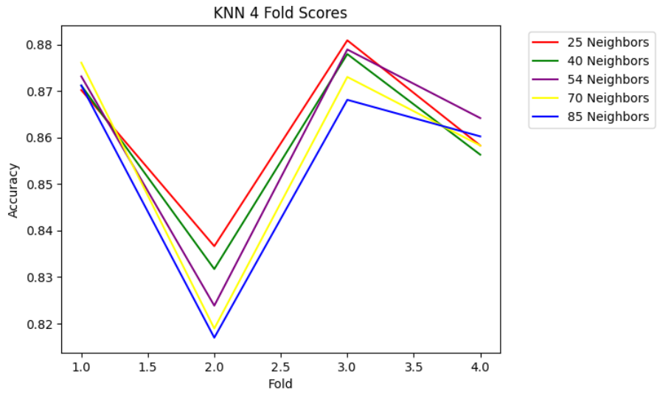
Knn: 4-fold evaluation
In Figure 3, I evaluated validation accuracies across the 4-folds to determine if there is overfitting
K=54 validation stayed within .04-.06 range
No big jumps, so overfitting is unlikely
K = 25 Gap: 0.0443
K = 40 Gap: .0462
K = 54 Gap: .0555
K = 70 Gap: 0.0572
K = 80 Gap: .0543
Figure 3

Slide 6
SVM: gridsearch
Parameters:
Used PCA, Scaled, and Original data
Gammas = [1e-5, 1e-4, 1e-3, 1e-2, 0.1, 1, 10]
Cs = [.01, .1, 1, 10, 20]
Evaluation:
Training & validation accuracy,
Conclusion:
Best overall dataset: PCA50
For each dataset’s findings, view Figure 4
Dataset | Findings
Original | Lowest training & validation accuracy across all C and gamma iterations
PCA10 | Lower training & validation accuracy than other datasets but much smaller gap between accuracies
Scaled, PCA 200, PCA 400 | All have relatively similar training and validation accuracies but much larger gap between accuracies compared to PCA10
PCA50 | Appears to be able to bridge the gap between PCA10 and Scaled/PCA 200/ PCA 400 as it has higher accuracies than PCA 10 but a smaller gap than Scaled, etc.
Figure 4

Slide 7
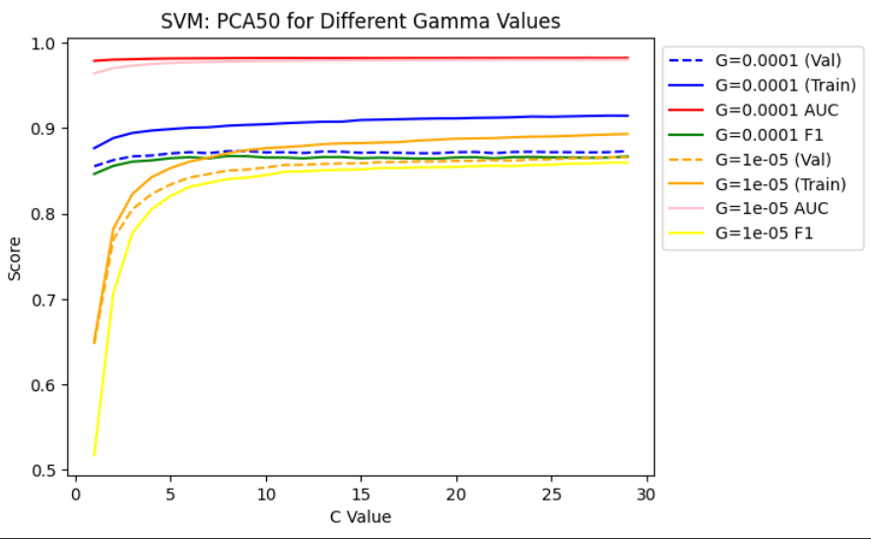
SVm: Optimal parameters for pca50
Parameters:
Gamma = .00001 or .0001
C = 1-30
Optimal Parameters
Gamma = .00001, C = 16
Training = 0.8813
Validation = 0.8600
Difference = 0.0231
AUC of ROC = 0.9796
F1 = 0.8531
As shown in Figure 5, for both Gammas, AUC of ROC are very similar, but Gamma = .00001 significantly reduces the gap in accuracies. At C=16, the F1 scores for both Gammas begin to converge
Figure 5

Slide 8
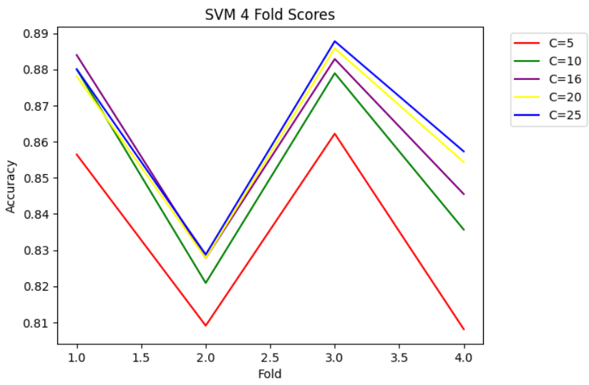
SVM: 4-fold evaluation
Evaluate validation accuracies across the 4-folds to determine if there is overfitting
C=16 validation stayed within .05-.06 range
As shown in Figure 6, there are no big jumps, so overfitting is unlikely
Figure 6

Slide 9
Random forest: gridsearch
Parameters:
Used PCA, Scaled, and Original data
Depths = [3, 6, 9, 12, 15, 18]
Nodes = [10, 20, 30, 40, 50]
Evaluation:
Training & validation accuracy
Conclusion:
Best overall dataset: PCA50 or PCA10
For each dataset’s findings, view Figure 7
Dataset | Findings
Original & Standard Scaler | Identical training and validation scores (normalization has no impact on decision trees) and usually a large gap between accuracies
PCA10 | Appears to even out at nodes = 20, depths from 9-18 at train around 0.81 and validation at around .77
PCA50 | Also appears to even out at nodes = 20, depths from 9-18 at train around .82 and validation around .78
PCA200 & PCA400 | Both appear to overfit the data as the gap between accuracies grow showing that the increased components add more noise than value to the model
Figure 7

Slide 10
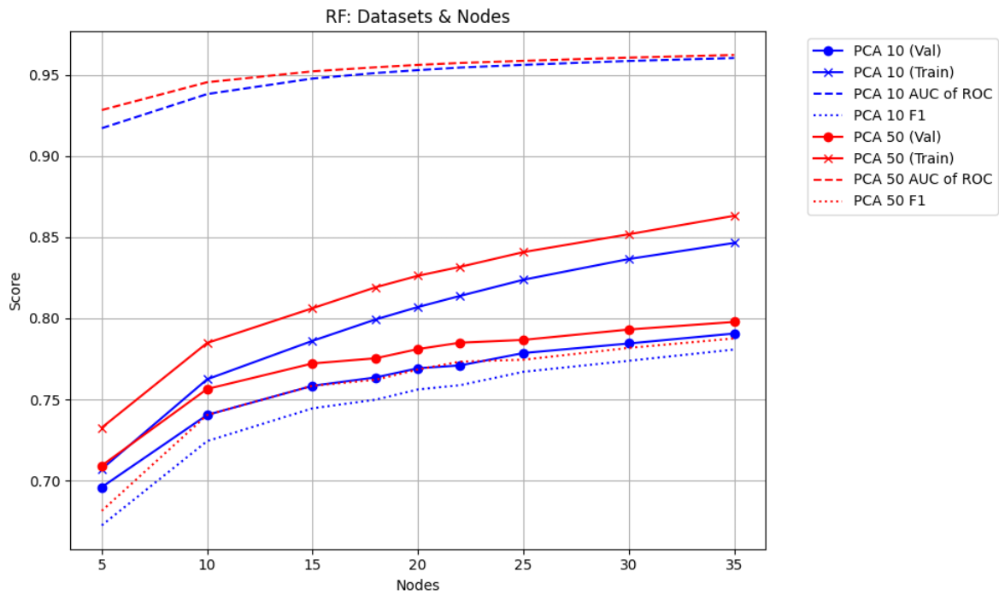
Random forest: Optimal parameters for pca50
Parameters:
Dataset = PCA10, PCA50
Max Depth = None (GridSearch showed that max nodes had no impact on accuracies)
Nodes = [5, 10, 15, 20, 25, 30, 35]
Optimal Parameters
Dataset = PCA50
Max Nodes = 20
Training = 0.8262
Validation = 0.7811
Difference = 0.0452
AUC of ROC = 0.9562
F1 = 0.7685
As shown in Figure 8, at nodes = 20, I minimized the gap between accuracies. For both datasets, the gap was very similar, but PCA50 had a better F1 and AUC of ROC score.
However, since this model has a much lower accuracy than the previous two, I believe that it is likely underfitting the data as decision trees are unable to handle the complexity of this dataset
Figure 8

Slide 11
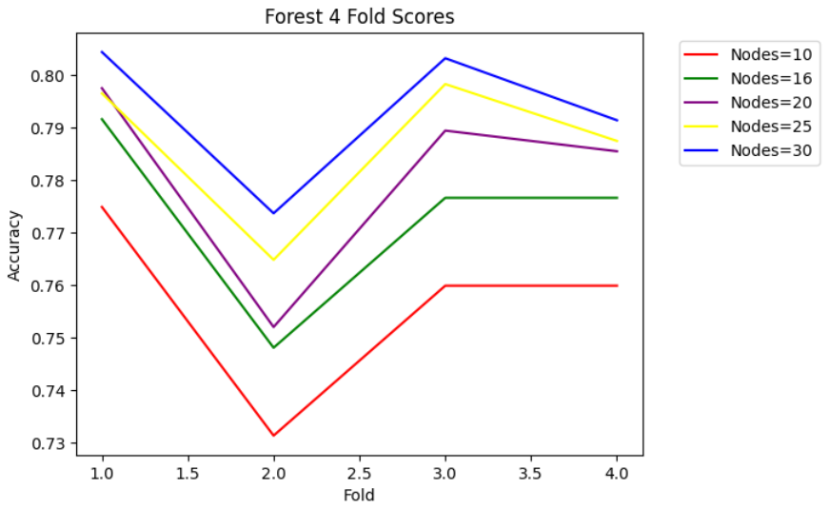
Random forest: 4-fold evaluation
Evaluate validation accuracies across the 4-folds to determine if there is overfitting
Range of .73 - .8
As shown in Figure 9, nodes = 20 helps minimize the change in folds as it stays in the middle of the other nodes
Figure 9

Slide 12
MLP: gridsearch & Pipeline
Gridsearch
Parameters:
Used PCA, Scaled, and Original data
Hidden Layers= [[50], [30, 30], [80], [50, 50], [100], [60, 70], [150]]
Alpha = [.3, .8, 1, 1.2, 1.5, 1.9, 2.1, 2.5]
Evaluation:
Training & validation accuracy to find dataset that gives highest accuracy and dataset that gives closest training & validation accuracies
Conclusion:
Dataset with highest accuracy: Original Data
Dataset with smallest gap between accuracies: PCA10
Gridsearch & Pipeline
Parameters:
Original data, PCA10
Hidden Layers = [[60], [40, 50], [70, 40], [130], [180]]
Alpha = [3.7, 4.1, 4.5, 4.9, 5.4, 5.8]
Evaluation:
Training & validation accuracy, AUC of ROC, F1 measure to understand impact of increasing alpha
Conclusion:
As alpha increased, the gap between accuracies in the Original data decreased. It had no impact on the PCA10 data. Original data had better AUC of ROC and F1 scores.
Best dataset: Original Data

Slide 13
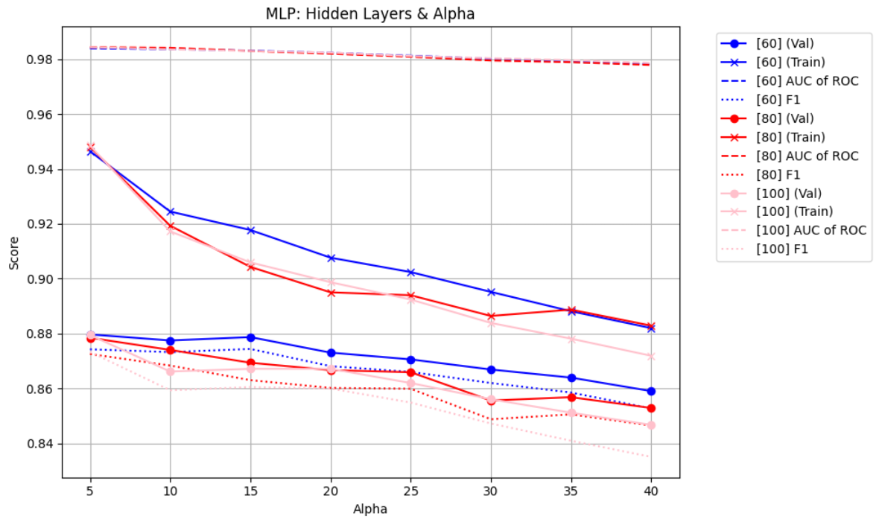
MLP: Optimal parameters for Original data
Parameters:
Dataset = Original
Hidden Layers = [60], [80], [100]
Alpha = [5, 10, 15, 20, 25, 30, 35, 40]
Optimal Parameters
Hidden Layers = 80, Alpha = 25
Training = 0.8940
Validation = 0.8659
Difference = 0.0281
AUC of ROC = 0.9809
F1 = 0.8599
As shown in Figure 10, at alpha = 25, I minimized the gap between accuracies. AUC remained consistently high, and this choice also yielded a higher F1 score.
Figure 10

Slide 14
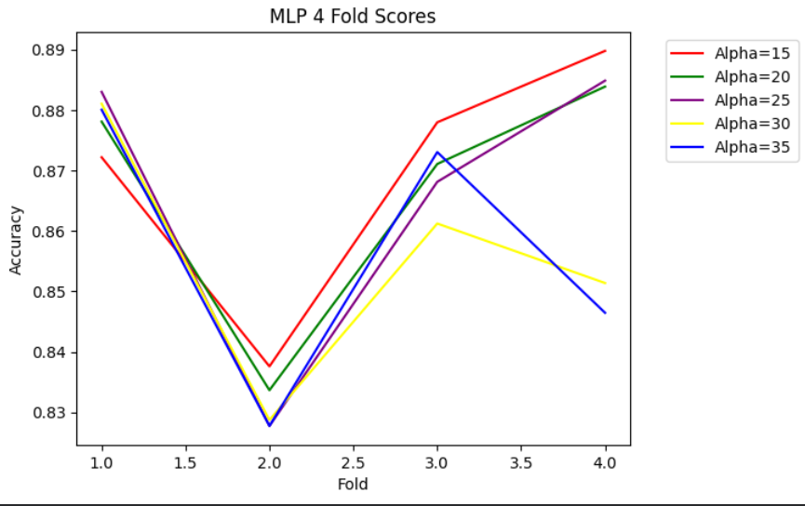
Mlp: 4-fold evaluation
In Figure 11, I evaluated validation accuracies across the 4-folds to determine if there is overfitting
Range of .83 - .9
Hidden Layers = [80]
Alpha = 25 helps minimize the change in folds as it stays in the middle of the other nodes
Figure 11

Slide 15
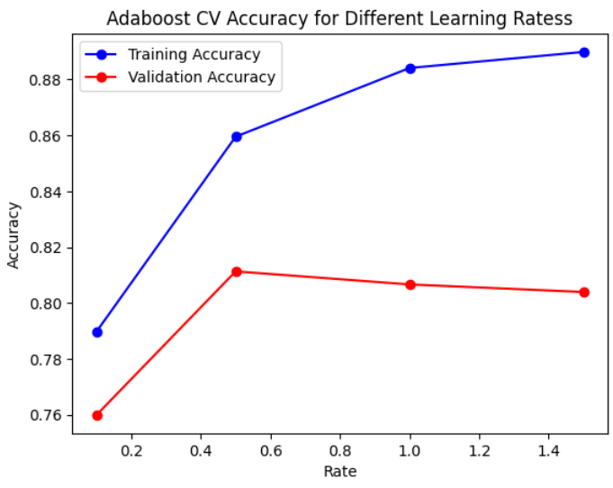
Adaboost
Parameters:
Decision Trees
Depth = 1
Estimators = 500
Learning Rate = [.1 .5, 1, 1.5]
Evaluation:
Training & validation accuracy
Conclusion:
As shown in Figure 12, Learning Rate = 0.5 finds sweet spot in the data, minimizing the gap between accuracies while still keeping relatively high validation accuracy
Decision Trees may be too simple for this data set as it also performed poorly with Random Forest
Figure 12

Slide 16
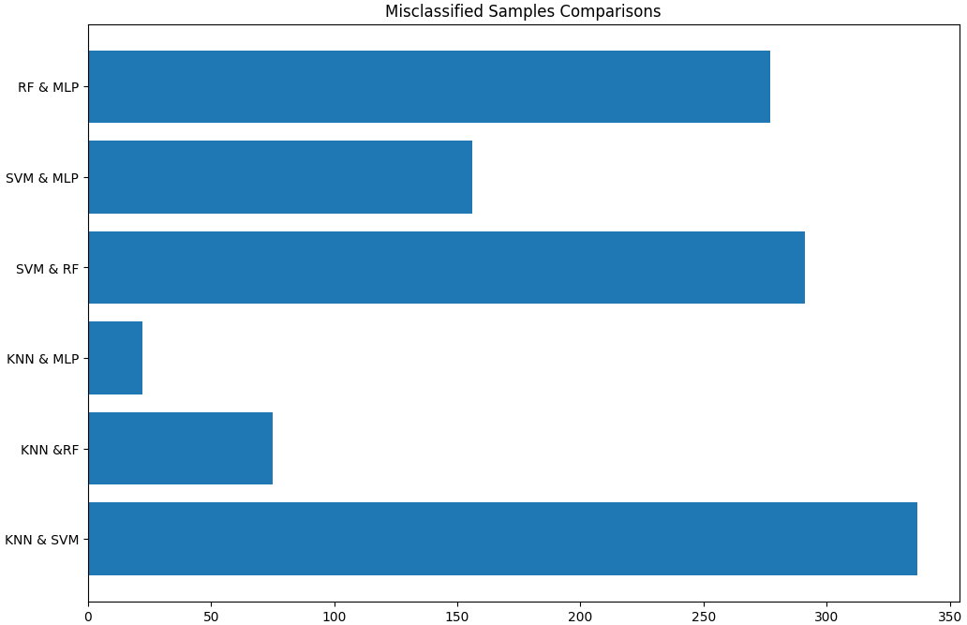
Stacking: choosing classifiers
Choosing Classifiers:
KNN
SVM
RF
MLP
In Figure 13, I compared misclassified samples in each classifier to see how many each one shared
Stacking 1: KNN & MLP
Based off of lowest shared misclassifications
Stacking 2: KNN & SVM
Highest accuracies using the same dataset and smallest gap between accuracies
Figure 13

Slide 17
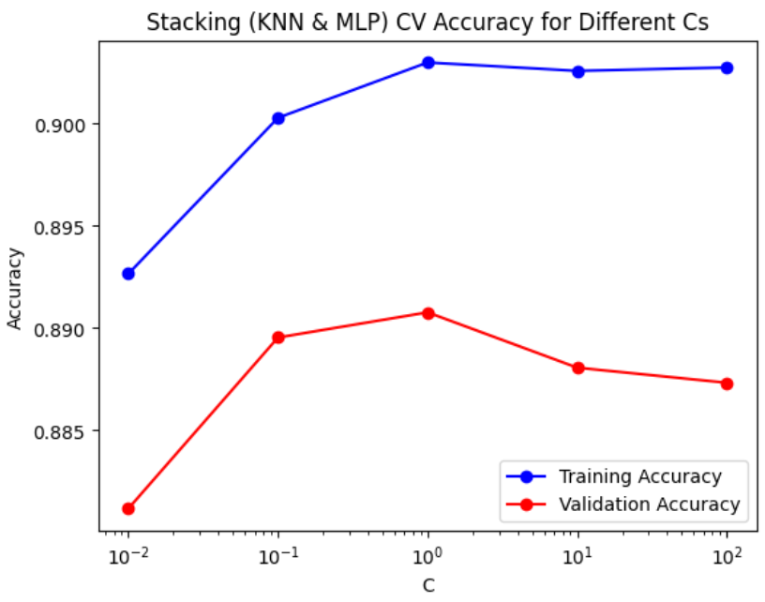
KNN & MLP Stacking: Optimal parameters
Base Learners: Optimize accuracies, AUC of ROC, F1
KNN: Scaled PCA 50 Dataset, Neighbors = 54
MLP: Original Dataset, Hidden Layers = [80], Alpha = 25
Meta Learner:
Logistic Regression:
C = [.01, .1, 1, 10, 100]
Optimal Parameters
C = 1
Training = 0.9030
Validation = 0.8908
In Figure 14, from C = .01 to 1, the gap remains steady at about 1. After C = 1, it steadily grows larger, causing potential overfitting.
Accuracy across the 4 folds remained very consistent – less than a .02 range
Figure 14

Slide 18
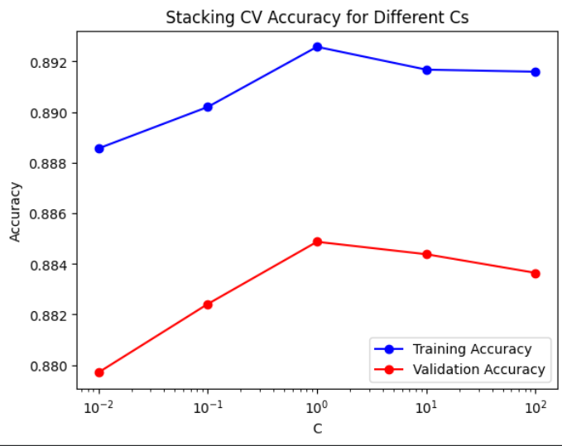
KNN & SVM Stacking: Optimal parameters
Base Learners: Optimize accuracies, AUC of ROC, F1
KNN: Scaled PCA 50 Dataset, Neighbors = 54
SVM: Scaled PCA 50 Dataset, Gamma = .00001, Alpha = 16
Meta Learner:
Logistic Regression:
C = [.01, .1, 1, 10, 100]
Optimal Parameters
C = 1
Training = 0.8902
Validation = 0.8848
In Figure 15, from C = .01 to 10, the gap remains steady at about 1. At C = 1, validation accuracy peaks
Accuracy across the 4 folds remained very consistent – less than a .02 range
Figure 15

Slide 19


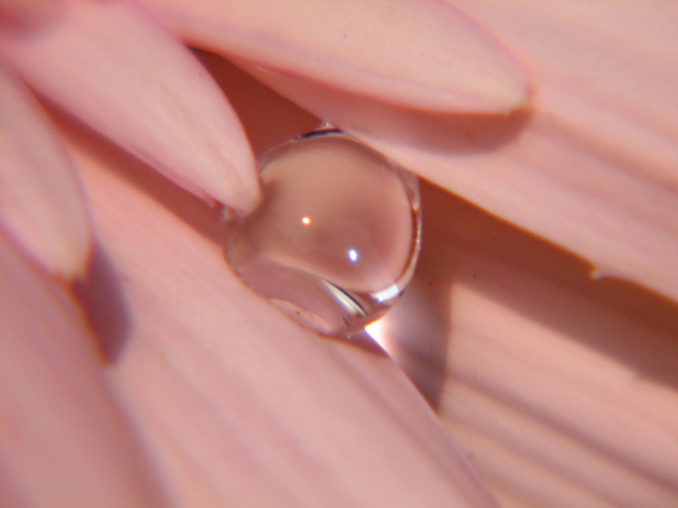



Common misclassifications
I found the first 5 misclassifications for each classifier, all of them in the Daisy class
Some misclassifications are shared by a lot of the other classifiers:
3: SVM, RF, MLP, Adaboost, Stacking KNN&MLP
18: KNN, SVM, RF, Stacking KNN&SVM
21: KNN, SV, RF, Stacking KNN&MLP, Stacking KNN&SVM
46: SVM, MLP, Adaboost, Stacking KNN&MLP, Stacking KNN&SVM
55: KNN, Adaboost, Stacking KNN&SVM
61: SVM, Stacking KNN&SVM
Themes:
Strong background (3, 18, 46): likely confuses classifier
Different colors (21, 55, 61): lack of white in the daisy
Figure 16: Sample 3
Figure 20: Sample 46
Figure 17: Sample 18
Figure 21: Sample 55
Figure 19: Sample 21
Figure 22: Sample 61

Slide 20
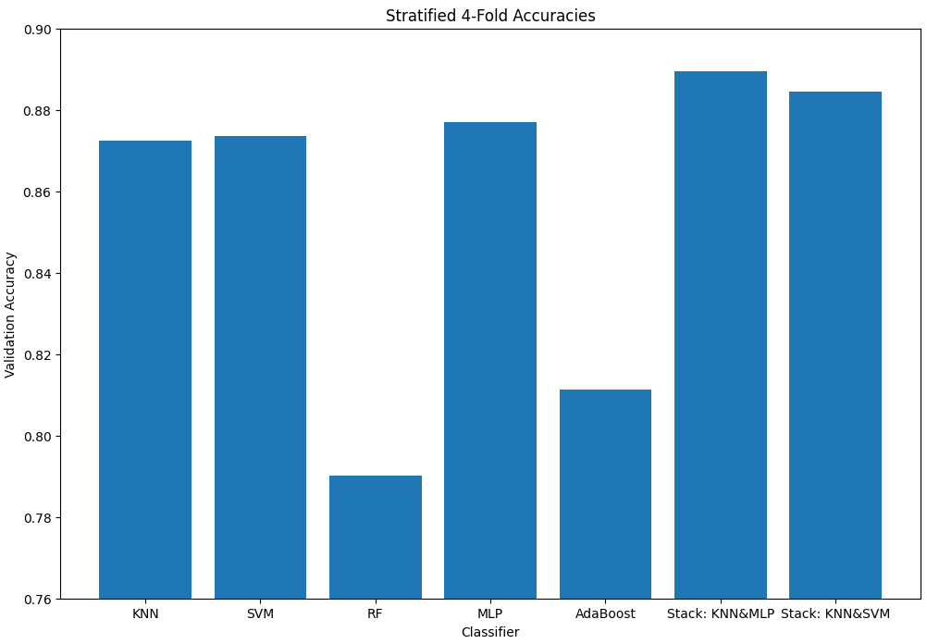
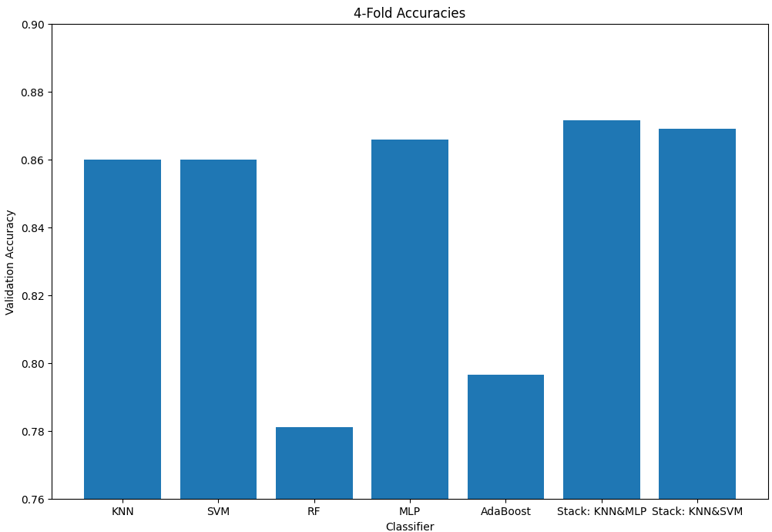
Classifier Comparisons
Figure 23
Evaluated all 7 classifiers using 4-fold cross validation (Figure 23) and 4-fold stratified cross-validation (Figure 24) since that was used for the ensembles
Order of best classifiers were mostly mirrored with both types of validations
1. KNN & MLP
2. KNN & SVM
3. MLP
4 & 5. KNN, SVM
SVM performed slightly better than KNN with the Stratified 4-fold
6. Adaboost
7. Random Forest
Figure 24

Slide 21
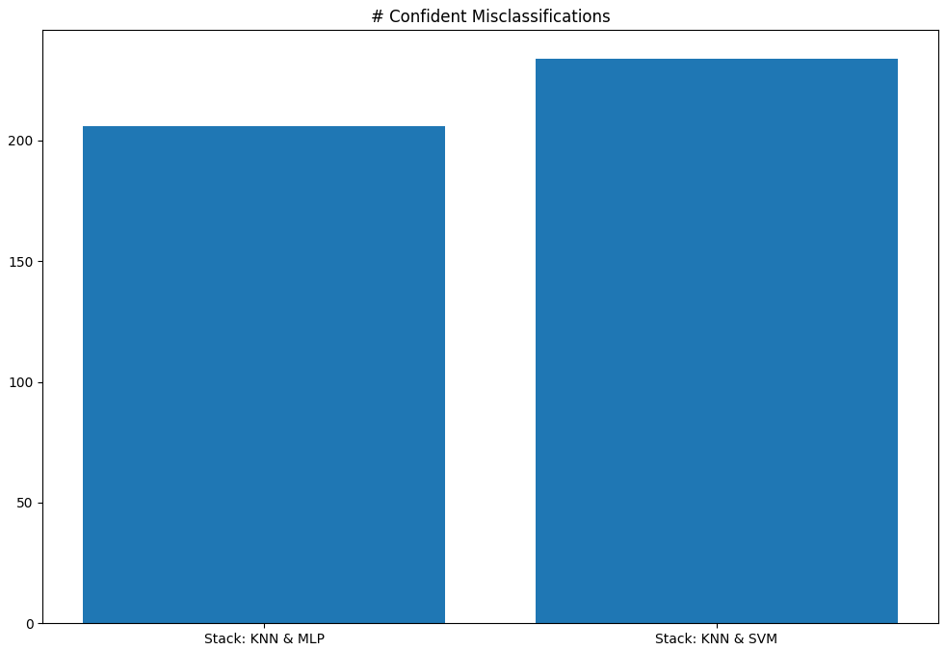
The best classifier
To choose between the two Stacking classifiers, I decided to analyze how confident they were classifying samples, specifically the samples they got wrong, which is shown in Figure 25
By seeing how many samples they incorrectly classified at over 0.60 confidence, I can evaluate which one is more accurate towards the data and will limit overfitting
In addition to having a high validation accuracy, the KNN & MLP Stacking Ensemble also was less confident on the misclassifications, making it the best model for this dataset
Figure 25

